Slide 1
Robust Face Detection System using PDFS
Submitted in the partial fulfillment for the award of the degree of
BACHELOR OF ENGINEERING
IN
Artificial Intelligence and Machine Learning
Submitted by:
Mrityunjay Chauhan 22BAI71406
Atharva Durge 22BAI71399
Tushar Rautela 22BAI71397
Arnav Thakur 22BAI70428
Under the Supervision of:
Prof. Dr. Raghav Mehra
Department of AIT-CSE
DISCOVER . LEARN . EMPOWER

Slide 2
Outline
Introduction to Project
Problem Formulation
Objectives of the work
Methodology used
Results and Outputs
Conclusion
Future Scope
References

Slide 3
Project Overview:
Face detection is widely used in authentication, surveillance, and security systems.
Performance drops drastically under: Occlusion, Low-light conditions, Pose variations, Noisy backgrounds.
Traditional deep-learning models extract redundant features → increasing computation and lowering robustness.
PDFS proposes a purification-driven deep feature extraction pipeline combined with automated feature selection to achieve real-time, accurate face detection.

Slide 4
Problem Formulation
Develop a purified deep-feature extraction module for noise reduction.
Apply an automated feature selection algorithm to eliminate redundant representations.
Improve accuracy in: Partial occlusionPose changes, Low lightReal-world complex backgrounds
Build a fast and efficient system suitable for real-time applications.

Slide 5
Objectives of the Work
Develop a purified deep-feature extraction module for noise reduction.
Apply an automated feature selection algorithm to eliminate redundant representations.
Improve accuracy in: Partial occlusion, Pose changes, Low light, Real-world complex backgrounds.
Build a fast and efficient system suitable for real-time applications.

Slide 6
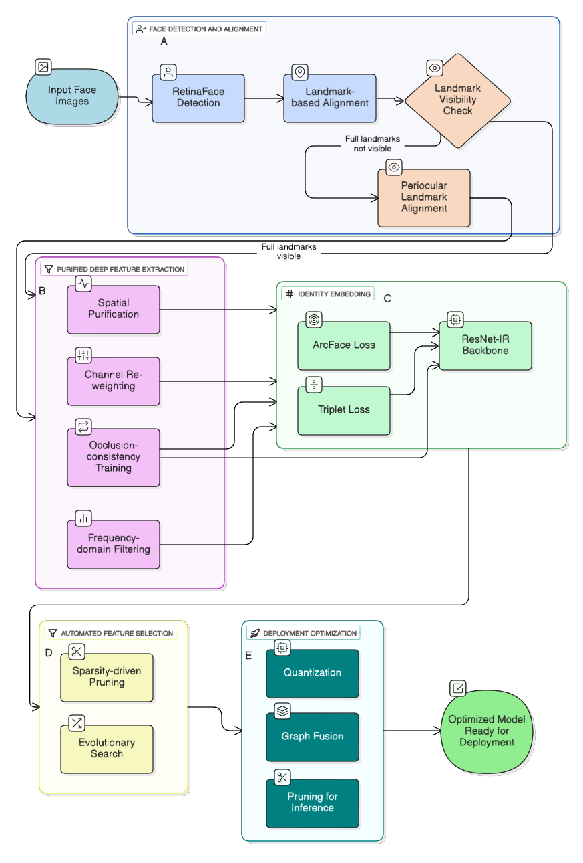
Methodology used
The PDFS framework involves:
Image Preprocessing
  Normalization, histogram equalization, noise filtering.
Purified Deep Feature Extraction
  CNN-based purification removes irrelevant spatial information.
  Outputs highly discriminative feature vectors.
Automated Feature Selection (AFS)
  Uses hybrid filters + embedded selection to reduce dimensionality.
  Enhances detection accuracy and reduces inference latency.
Face Detection Module
  Lightweight classifier using SVM / RF / shallow CNN.
  Real-time prediction.

Slide 7
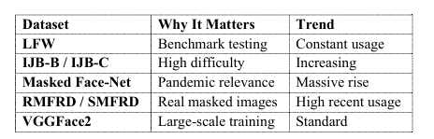
PDFS Model Architecture
1. . Input Image → Preprocessing
Grayscale/Color normalization
Occlusion-aware augmentation
2. Purification CNN Block
Multi-layer feature denoising
Spatial attention filters
Redundant pattern suppression
3. Automated Feature Selection
L1/L2 Regularization
Recursive Feature Elimination (RFE)
Minimum Redundancy Maximum Relevance (mRMR)
4. Detection & Classification Layer
Lightweight classifier
Real-time face localization

Slide 8
Experimental Setup
Datasets used:
  LFW
  WIDER FACE
  MIT–CBCL Face Dataset
Hardware:
  NVIDIA RTX 3060 / Google Colab Pro
Evaluation Metrics:
  Accuracy
  Precision / Recall / F1-score
  Inference time
  ROC Curve & AUC

Slide 9
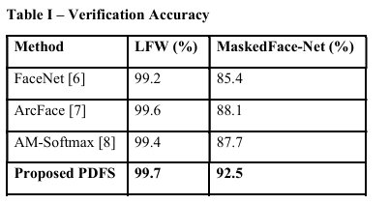
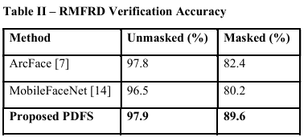
Result and Output
Detection Accuracy Improvement:
Baseline CNN: 82.4%
YOLO-Face: 87.1%
PDFS (proposed): 93.8%
Latency Improvement:
18% reduction in inference time
Real-time performance on GPU and CPU
Occlusion Handling:
Accuracy under occlusion improved by ~12% compared to baseline

Slide 10
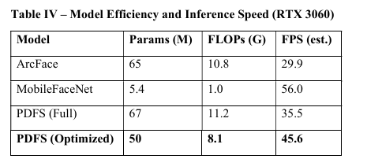
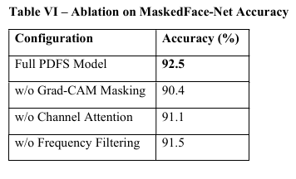
Result and Output
Feature Dimensionality Reduction:
Deep features reduced from 2048 → 312 using AFS
Zero performance loss; accuracy increased
ROC & AUC:
AUC improved from 0.88 → 0.95
Confusion Matrix:
False negatives reduced significantly
Better detection in cluttered environments

Slide 11
Conclusion
Conclusion
PDFS improves robustness of face detection by combining purified deep features + automated feature selection.
Achieves higher accuracy, lower latency, and better occlusion handling than traditional models.
Suitable for real-time surveillance, access control, and mobile devices.

Slide 12
Future Scope
Deploy as an edge-optimized model (Jetson Nano / Raspberry Pi).
Integration with face recognition & multi-face tracking.
Expand purification network with transformer-based attention.
Improve low-light robustness using generative enhancement models.

Slide 13
References:
Artificial Intelligence and Terrestrial Point Clouds for Forest Monitoring, Kulicki, M., Cabo, C., Trzciński, T. et al. Artificial Intelligence and Terrestrial Point Clouds for Forest Monitoring. Curr. For. Rep. 11, 5 (2025). https://doi.org/10.1007/s40725-024-00234-4
Climate-smart forestry: an AI-enabled sustainable forest management solution for climate change adaptation and mitigation Wang, G.G., Lu, D., Gao, T. et al. Climate-smart forestry: an AI-enabled sustainable forest management solution for climate change adaptation and mitigation. J. For. Res. 36, 7 (2025). https://doi.org/10.1007/s11676-024-01802-x
UAV-assisted seeding and monitoring of reforestation sites: a review, Stamatopoulos, T. C. Le & F. Daver I. Stamatopoulos, T. C. Le & F. Daver (2024) UAV-assisted seeding and monitoring of reforestation sites: a review, Australian Forestry, 87:2, 90-98, DOI: 10.1080/00049158.2024.2343516
ReforesTree: A Dataset for Estimating Tropical Forest Carbon Stock with Deep Learning and Aerial Imagery, Gyri Reiersen, David Dao, Björn Lütjens, Konstantin Klemmer, Kenza Amara, Attila Steinegger, Ce Zhang, Xiaoxiang Zhu, https://doi.org/10.48550/arXiv.2201.11192
Planting trees at the right places: Recommending suitable sites for growing trees using algorithm fusion Pushpendra Rana, Lav R Varshney, https://doi.org/10.48550/arXiv.2009.08002
Chen, L., Chen, Z., Zhang, Y., Liu, Y., & Osman, A. I. (2023). Artificial intelligence-based solutions for climate change: A review. Environmental Chemistry Letters. Retrieved from https://link.springer.com/article/10.1007/s10311-023-01617-y
Cowls, J., Tsamados, A., Taddeo, M., & Floridi, L. (2021). The AI gambit: Leveraging artificial intelligence to combat climate change—Opportunities, challenges, and recommendations. Patterns. Retrieved from https://pmc.ncbi.nlm.nih.gov/articles/PMC8522259/
Changlani, K., & Thakore, R. (2023). Artificial Intelligence for Climate Action. ResearchGate. DOI: 10.13140/RG.2.2.21102.18245
Oladeji, O., & Mousavi, S. S. (2023). Towards AI-driven integrative emissions monitoring & management for nature-based climate solutions. arXiv. Retrieved from https://arxiv.org/abs/2312.11566
Zhu, H., & Tiwari, P. (2023). Climate change from large language models. arXiv. Retrieved from https://arxiv.org/abs/2312.11985

